Slide 1
Angelo Gaerlan – RF Regression Model

Slide 2
About the Dataset
The Dataset was created by IBM data scientists to examine Employee Attrition.
Attrition is the permanent removal of a position within a company.
Contains information about employees such as Income, Job Level, Age, and Attrition Status.

Slide 3
Purpose of the Project
PURPOSE: Develop a regression model to predict monthly income.

Slide 4
Step 1: DATA CLEANING
The first step is to clean the data.
Missing Values
No missing values in the dataset
Dropped constant columns
These columns do not provide extra information about the target variable.
Converting text to all lower case.

Slide 5
Step 1: DATA CLEANING – OUTLIERS
Outliers can skew regression models.
However, we decided not to drop any outliers for the following reasons:
1. Dropping outliers would mean dropping 47% of rows in the dataset.
2. The model we are using, Random Forest, is not sensitive to outliers.

Slide 6
Step 2: Feature Selection
Feature Selection is the process of choosing independent variables.
For Continuous Variables, we selected based on:
Pearson’s and Spearman Correlation
Visual inspection of scatter plots
For Categorical Variables we selected based on:
Boxplots – choose independent variables that have different income distributions for each category
Average income for class in a category.

Slide 7
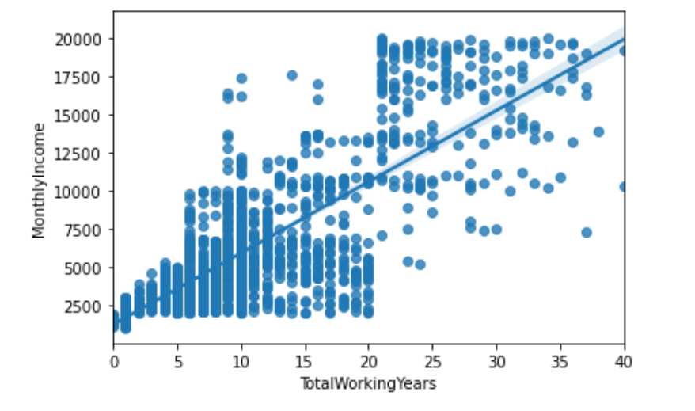
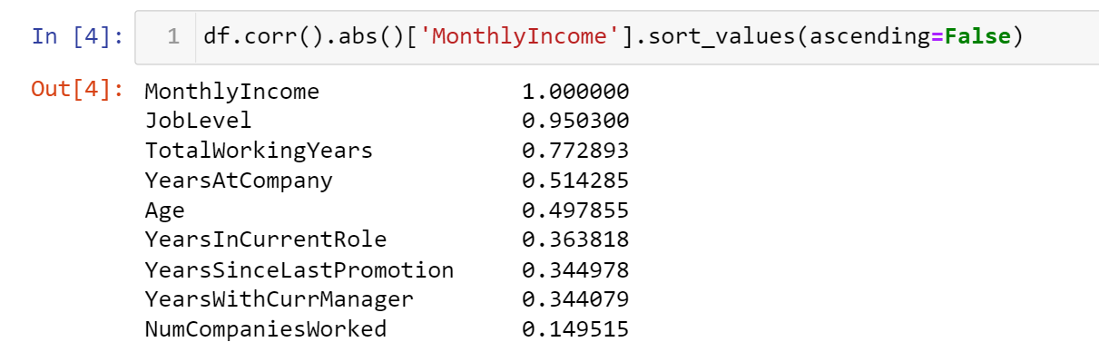
Choosing Continuous Features
Visual Inspection of Scatter Plots
Pearson’s and Spearman Correlation

Slide 8
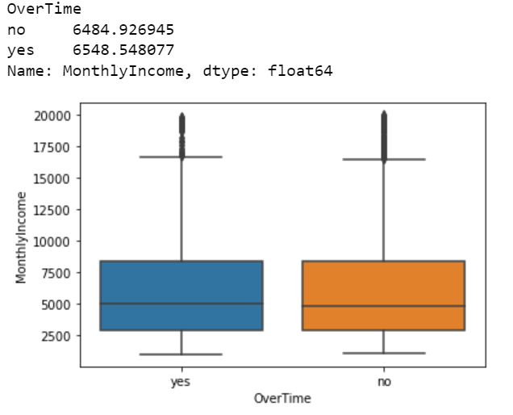
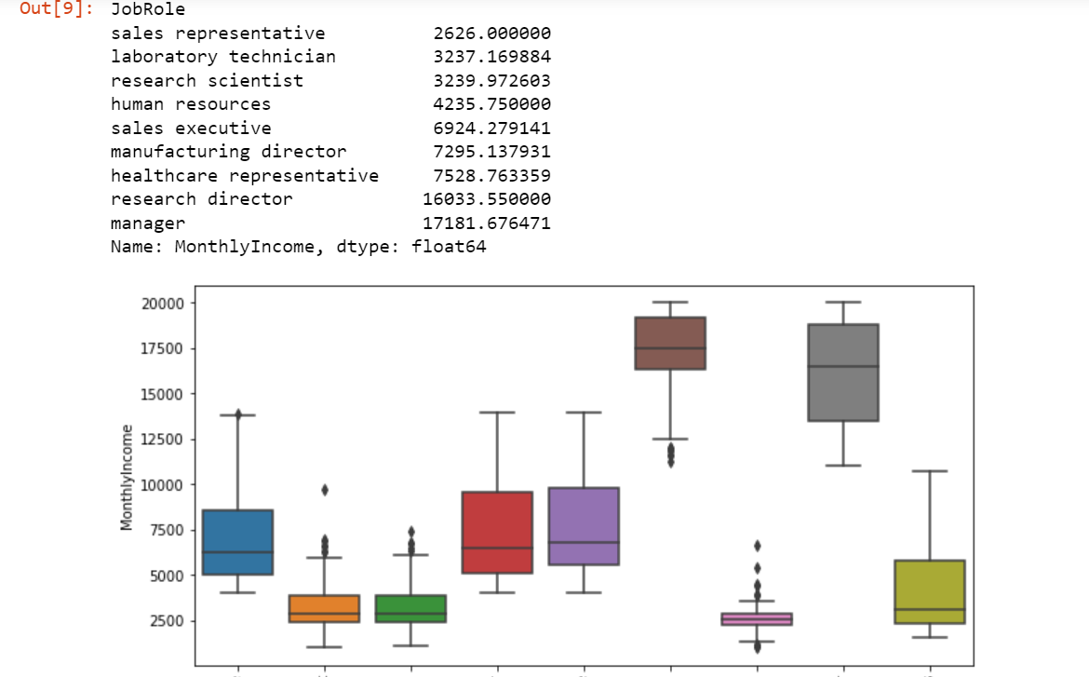
Choosing Categorical variables
FEATURE DISCARDED
FEATURE USED

Slide 9
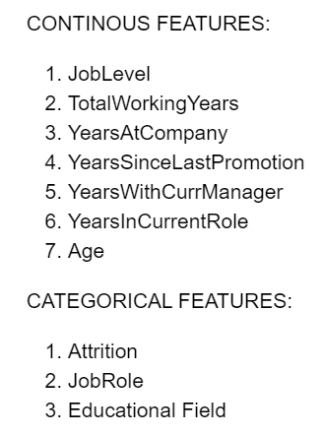
Selected Features

Slide 10
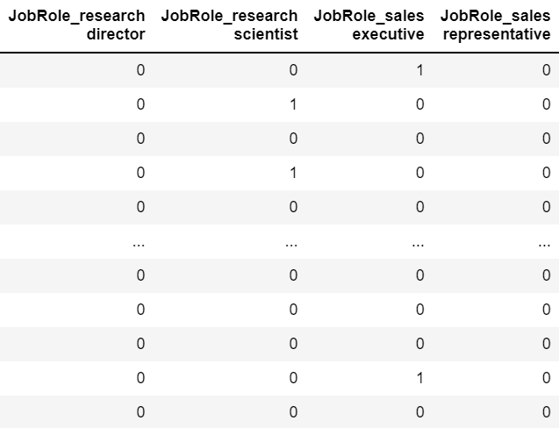
Step 3: Data Preparation
Split the dataset into training and test sets.
75% Training
25% Testing
One-hot encoded categorical features

Slide 11
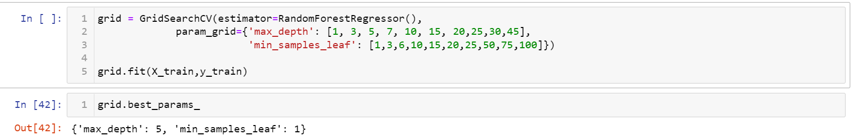
Step 4: Hyperpameter Tuning
Utilized GridSearchCV on the training set to tune hyperparameters.
This is done to maximize the performance of the model.

Slide 12
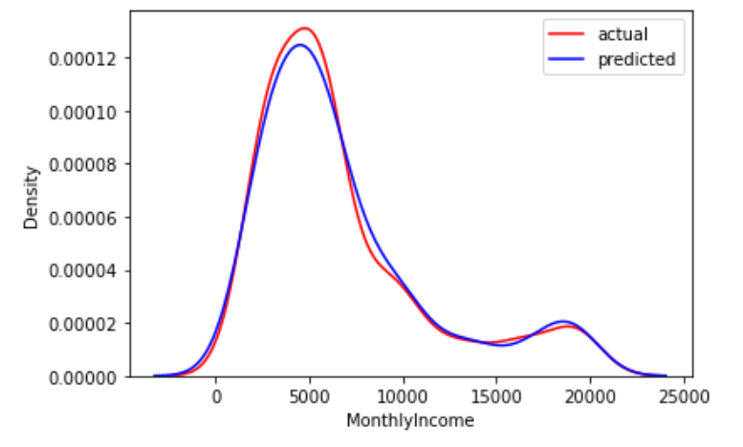
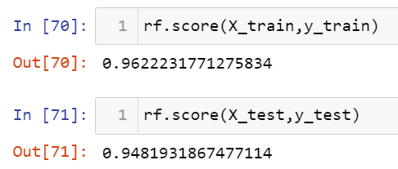
Step 5: Training the model and predicting the testing set

Slide 13
Conclusion
We chose Random Forest due to the high number of outliers in the dataset.
The model is able to predict almost perfectly the training and testing set.

Slide 14
Any Questions?

